Slide 1
R GUI building
Chen Hao
7 Oct 2014

Slide 2
GUIs are used to allow the user to easily accomplish the tasks in hand.
Many more R GUIs are now available:
- Tcl/Tk, rpanel.
- Gtk, Gwidgets, PMG (Poor Man’s GUI).
- Java based GUIs: rJava, JGR
- Web based: Rpad,Rwui.
Notes:
The gWidgets package provides a convenient means to create rapidly small to medium-size GUIs within R. Unlike the underlying toolkits, gWidgets has relatively few constructors and methods, which mean it is relatively easy to learn, allowing for rapid prototyping. (but as project progress, one might need to move to a more powerful underlying toolkit). The gWidgets package works with different operating systems and different GUI toolkits. This shows, the same code using the RGtk2, tcltk, qtbase packages for a toolkit.
Despite Tk’s limitations as a graphical toolkit as compared to GTK+ or Qt, the Tk libraries are widely used for R GUIs.

Slide 3
tcltk
Tcl: Tool Command Language - in the late 1980s by John Ousterhout
Tk: is an extension of Tcl that provides GUI components through Tcl - in 1990, again by John Ousterhout
Tcl/Tk is a combination of a scripting language and a toolkit for graphical user interfaces.
Notes:
it made programming GUIs for X11 easier and faster. There are a large number of language bindings available for Tk, including Perl, Python, Ruby, and, through the tcltk package, R. The tcltk package was developed by Peter Dalgaard and has been included with base R since version 1.1.0. The tcltk2
package provides additional bindings and bundles in some useful external TCL code. Our focus here is limited to the base tcltk package.
R for Windows has been bundled with the necessary Tk version for years, so there are no installation issues for that platform. For Linux users, it is typically trivial to install the newer libraries, and for Mac OS X users, the provided binary installations include the newer Tk libraries.

Slide 4
Widgets
A widget is a GUI element, like buttons, scrollbars, text areas etc.
Tk comes with a selection of basic widgets:
These can be combined to form more complex GUI applications.
text editing windows
Sliders
text entry fields
Buttons
Labels
Menus
list boxes
canvas for drawing graphics
Notes:
A widget along the top or bottom is allocated a parcel just high enough to contain the widget, but occupying as much of the width of the container as possible, whereas widgets along the sides get a parcel of maximal height, but just wide enough to contain it.

Slide 5
Layout and Containers
Top-level windows tktoplevel constructor. Basic options include the ability to specify the preferred width and height and to specify a menu bar through the menu argument.
Frames ttkframe constructor produces a themeable container that can be used to organize visible components within a GUI. Options include width and height to set the required size. The padding option can be used to put space between the border and subsequent children. The option borderwidth to specify a border around the frame of a given width, and relif to set the border style. Like “flat”, "groove", "raised", "ridge", "solid", and "sunken".

Slide 6
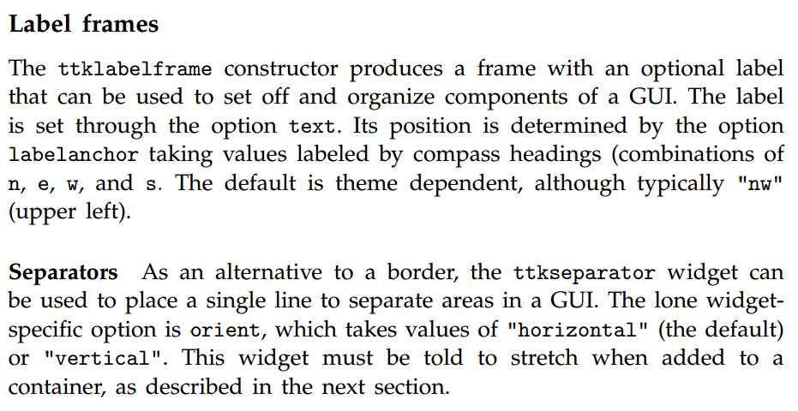

Slide 7
Geometry managers
The tkpack function will place children into their parent in a boxlike manner
When simultaneous horizontal and vertical alignment of child components is desired, the tkgrid function can be used to manage the components.

